Slide 1
birds
have a covered with feathers, forelimbs modified into wings, scaly legs, a beak and no teeth, and bearing young in a hard shelled egg.

Slide 2
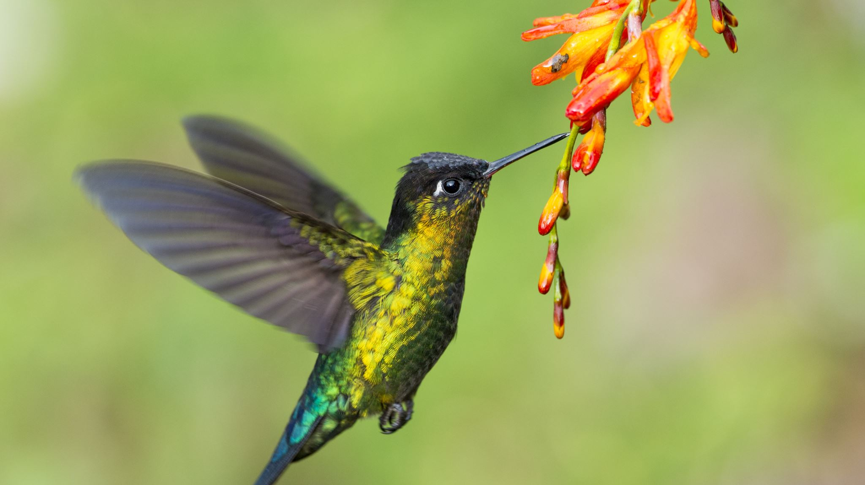
The birds

Slide 3
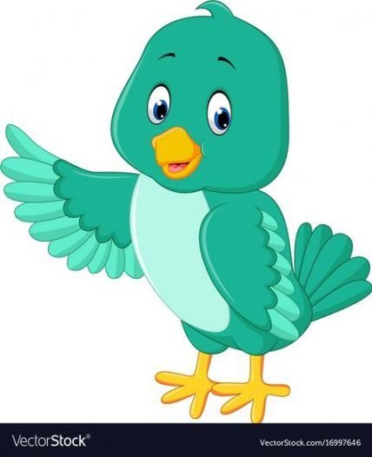
Part of the birds
HEAD
EYES
BEAK
WINGS
CHEST
TAIL
The body is covered with feathers and two legs covered with scale
The mouth of the bird is called beak
LEG

Slide 4
Song birds

Slide 5
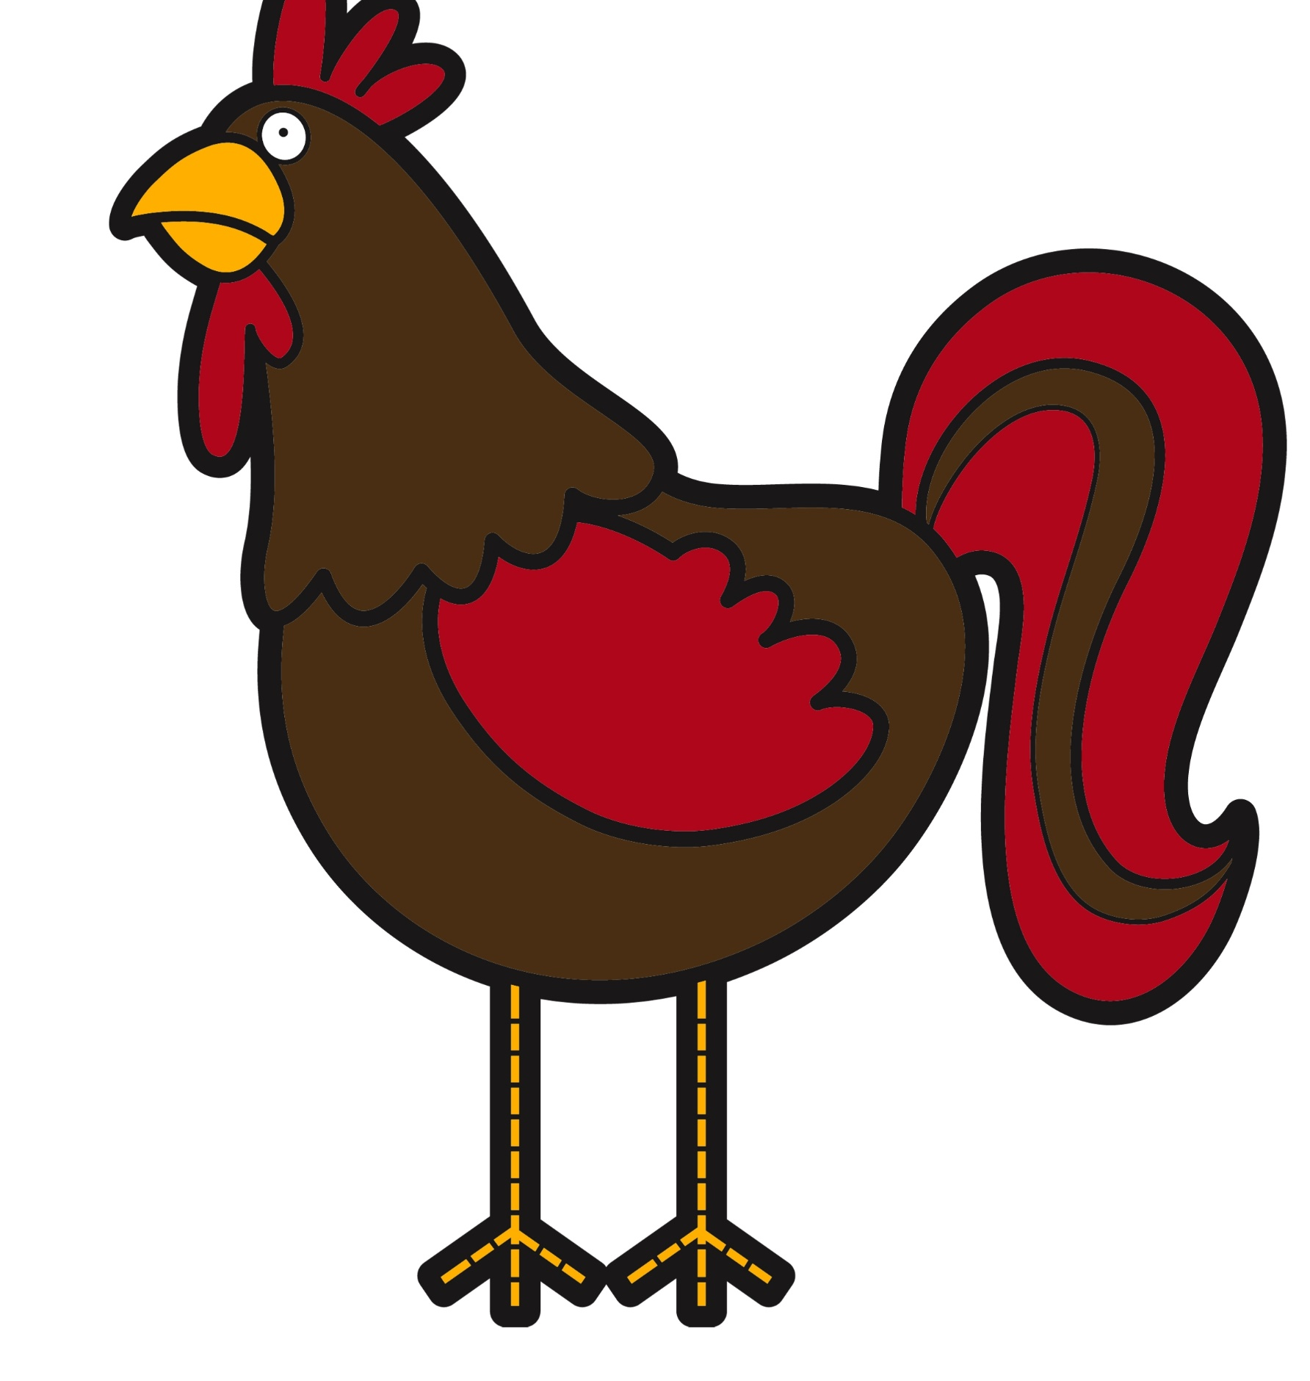
Common birds
ROOSTER
DUCK
HEN

Slide 6
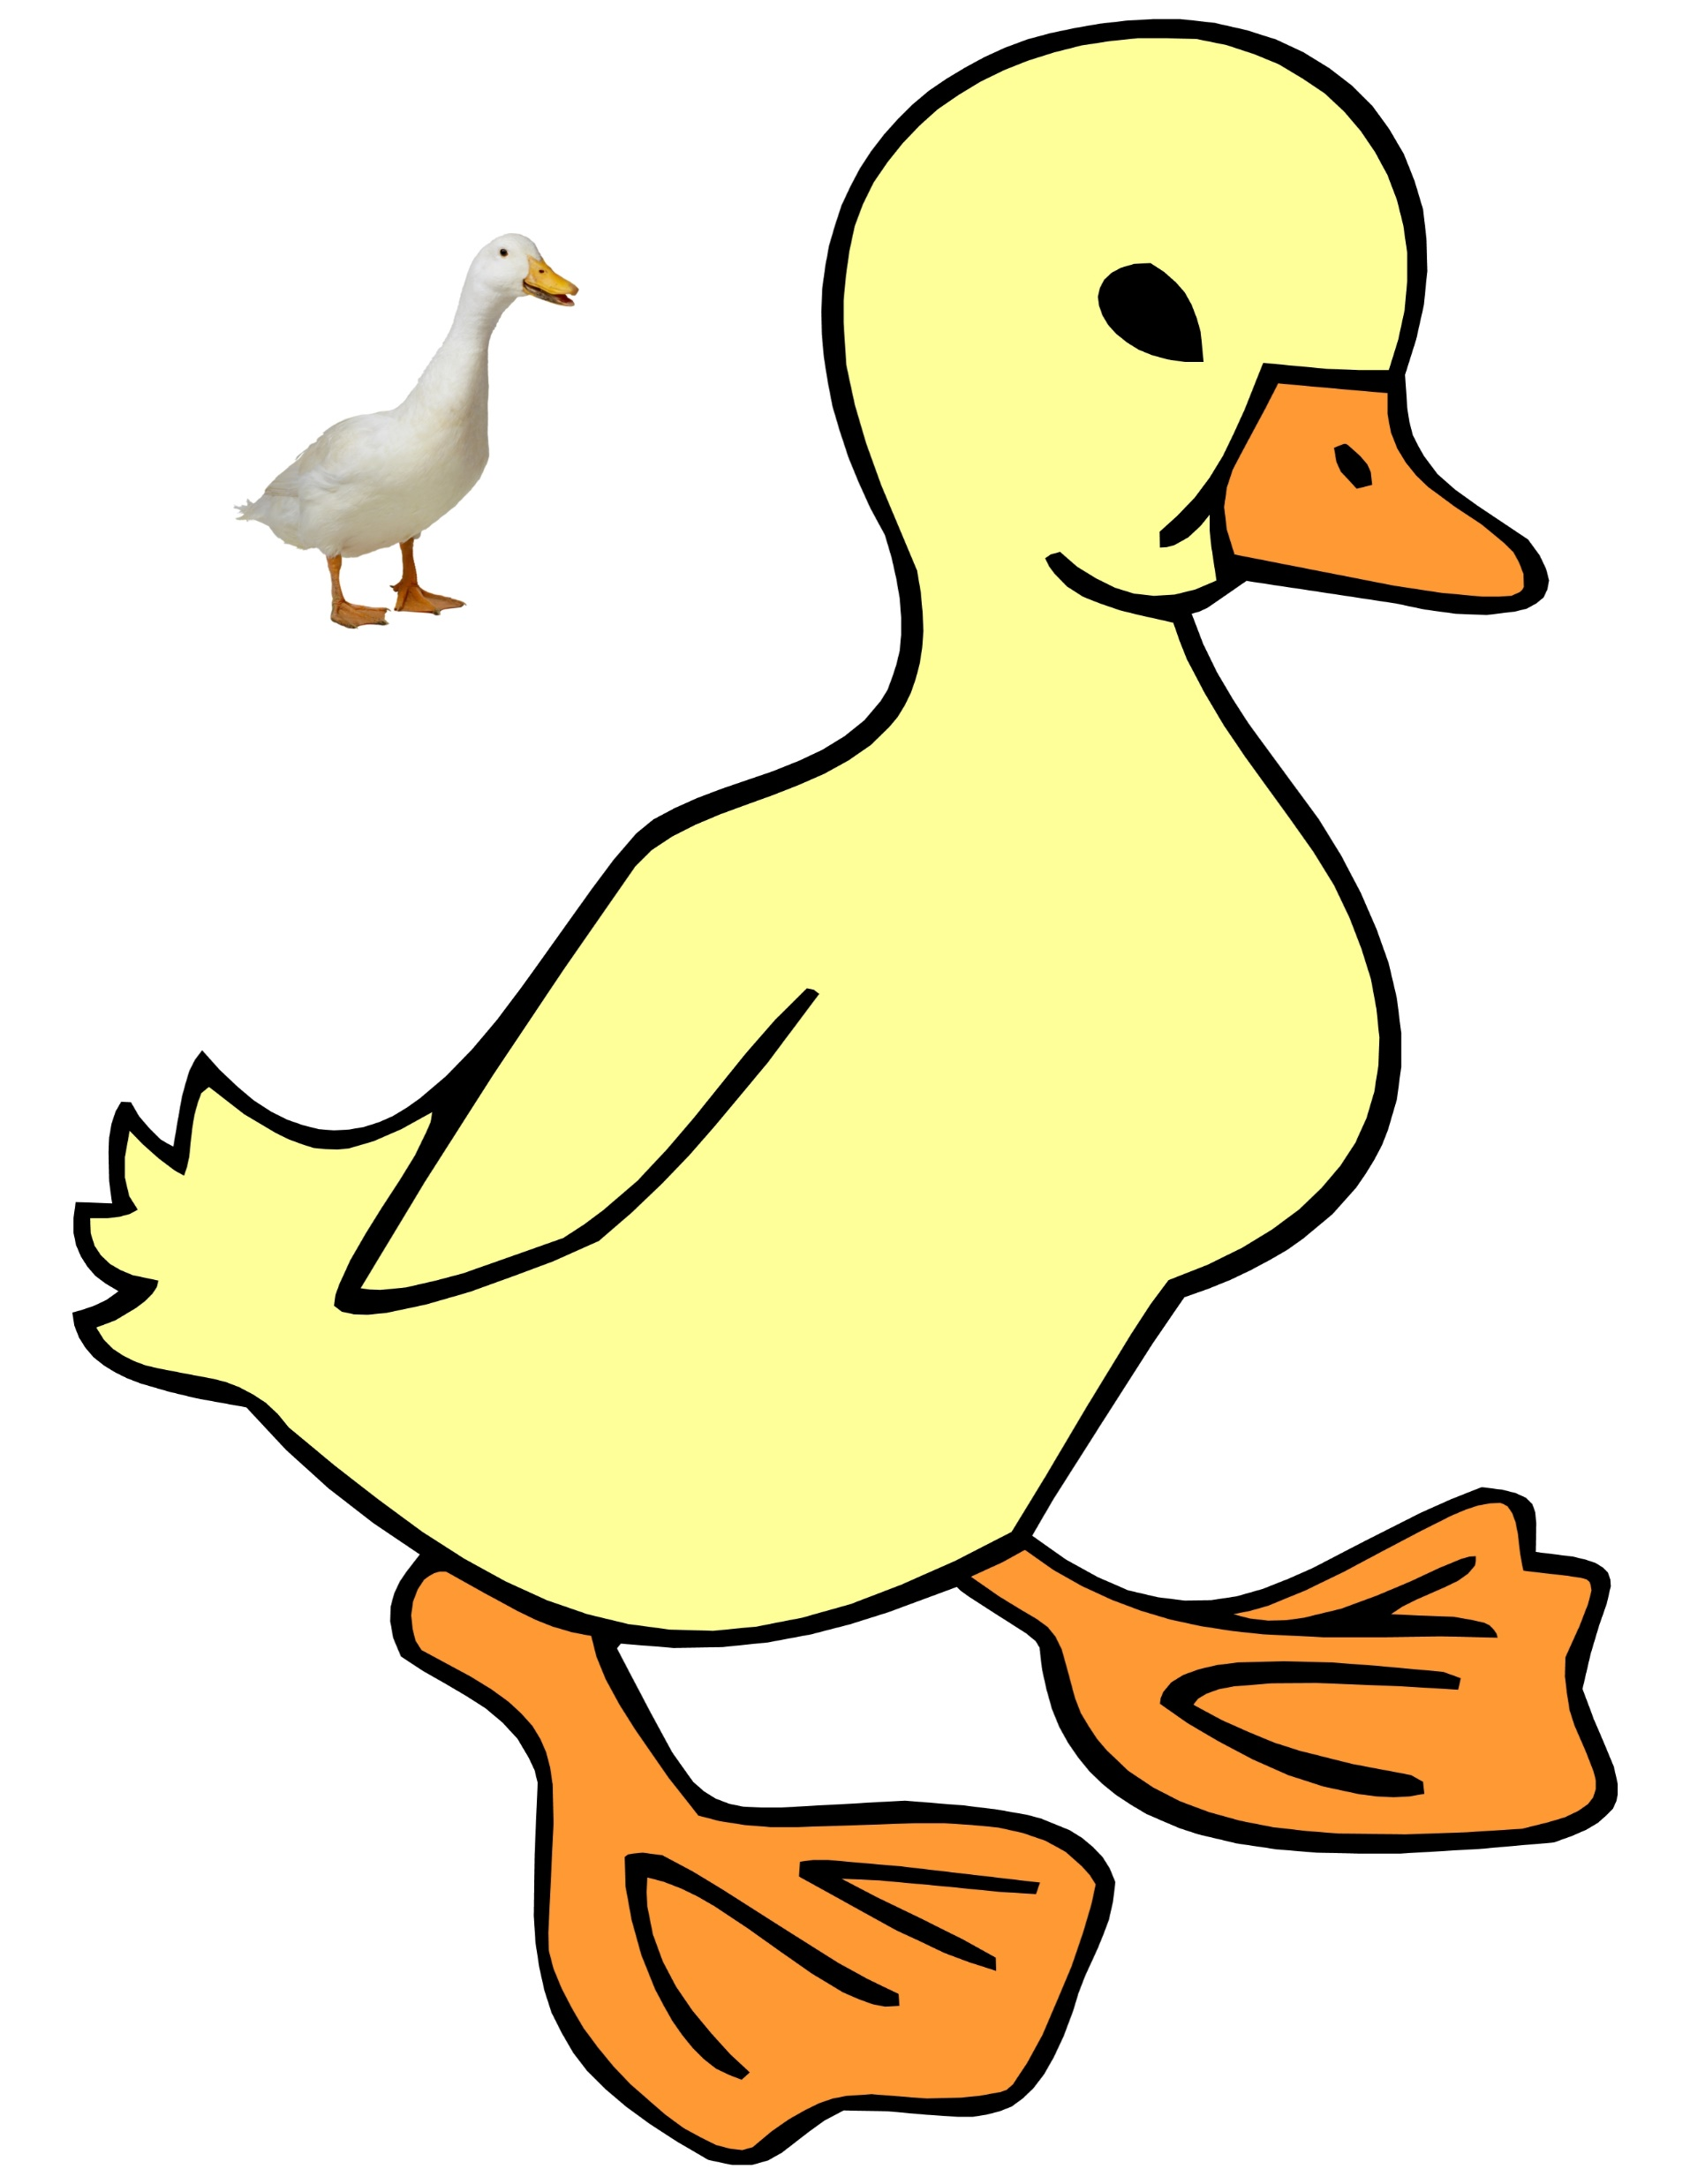
Which number is the rooster
1
2
3
Number 1 is the Rooster

Slide 7
Which number is the hen ?
1
2
3
Number 3 is the hen

Slide 8
Which number is the duck?
1
2
3
Number 2 is the duck

Slide 9
Common birds
HUMMINGBIRD
CROW
ROBIN

Slide 10
Which number is the crow?
1
2
3
Number 2 is the crow

Slide 11
Which number is the robin?
1
2
3
Number 3 is the robin

Slide 12
Which number is the hummingbird?
1
2
3
Number 1 is the hummingbird

Slide 13
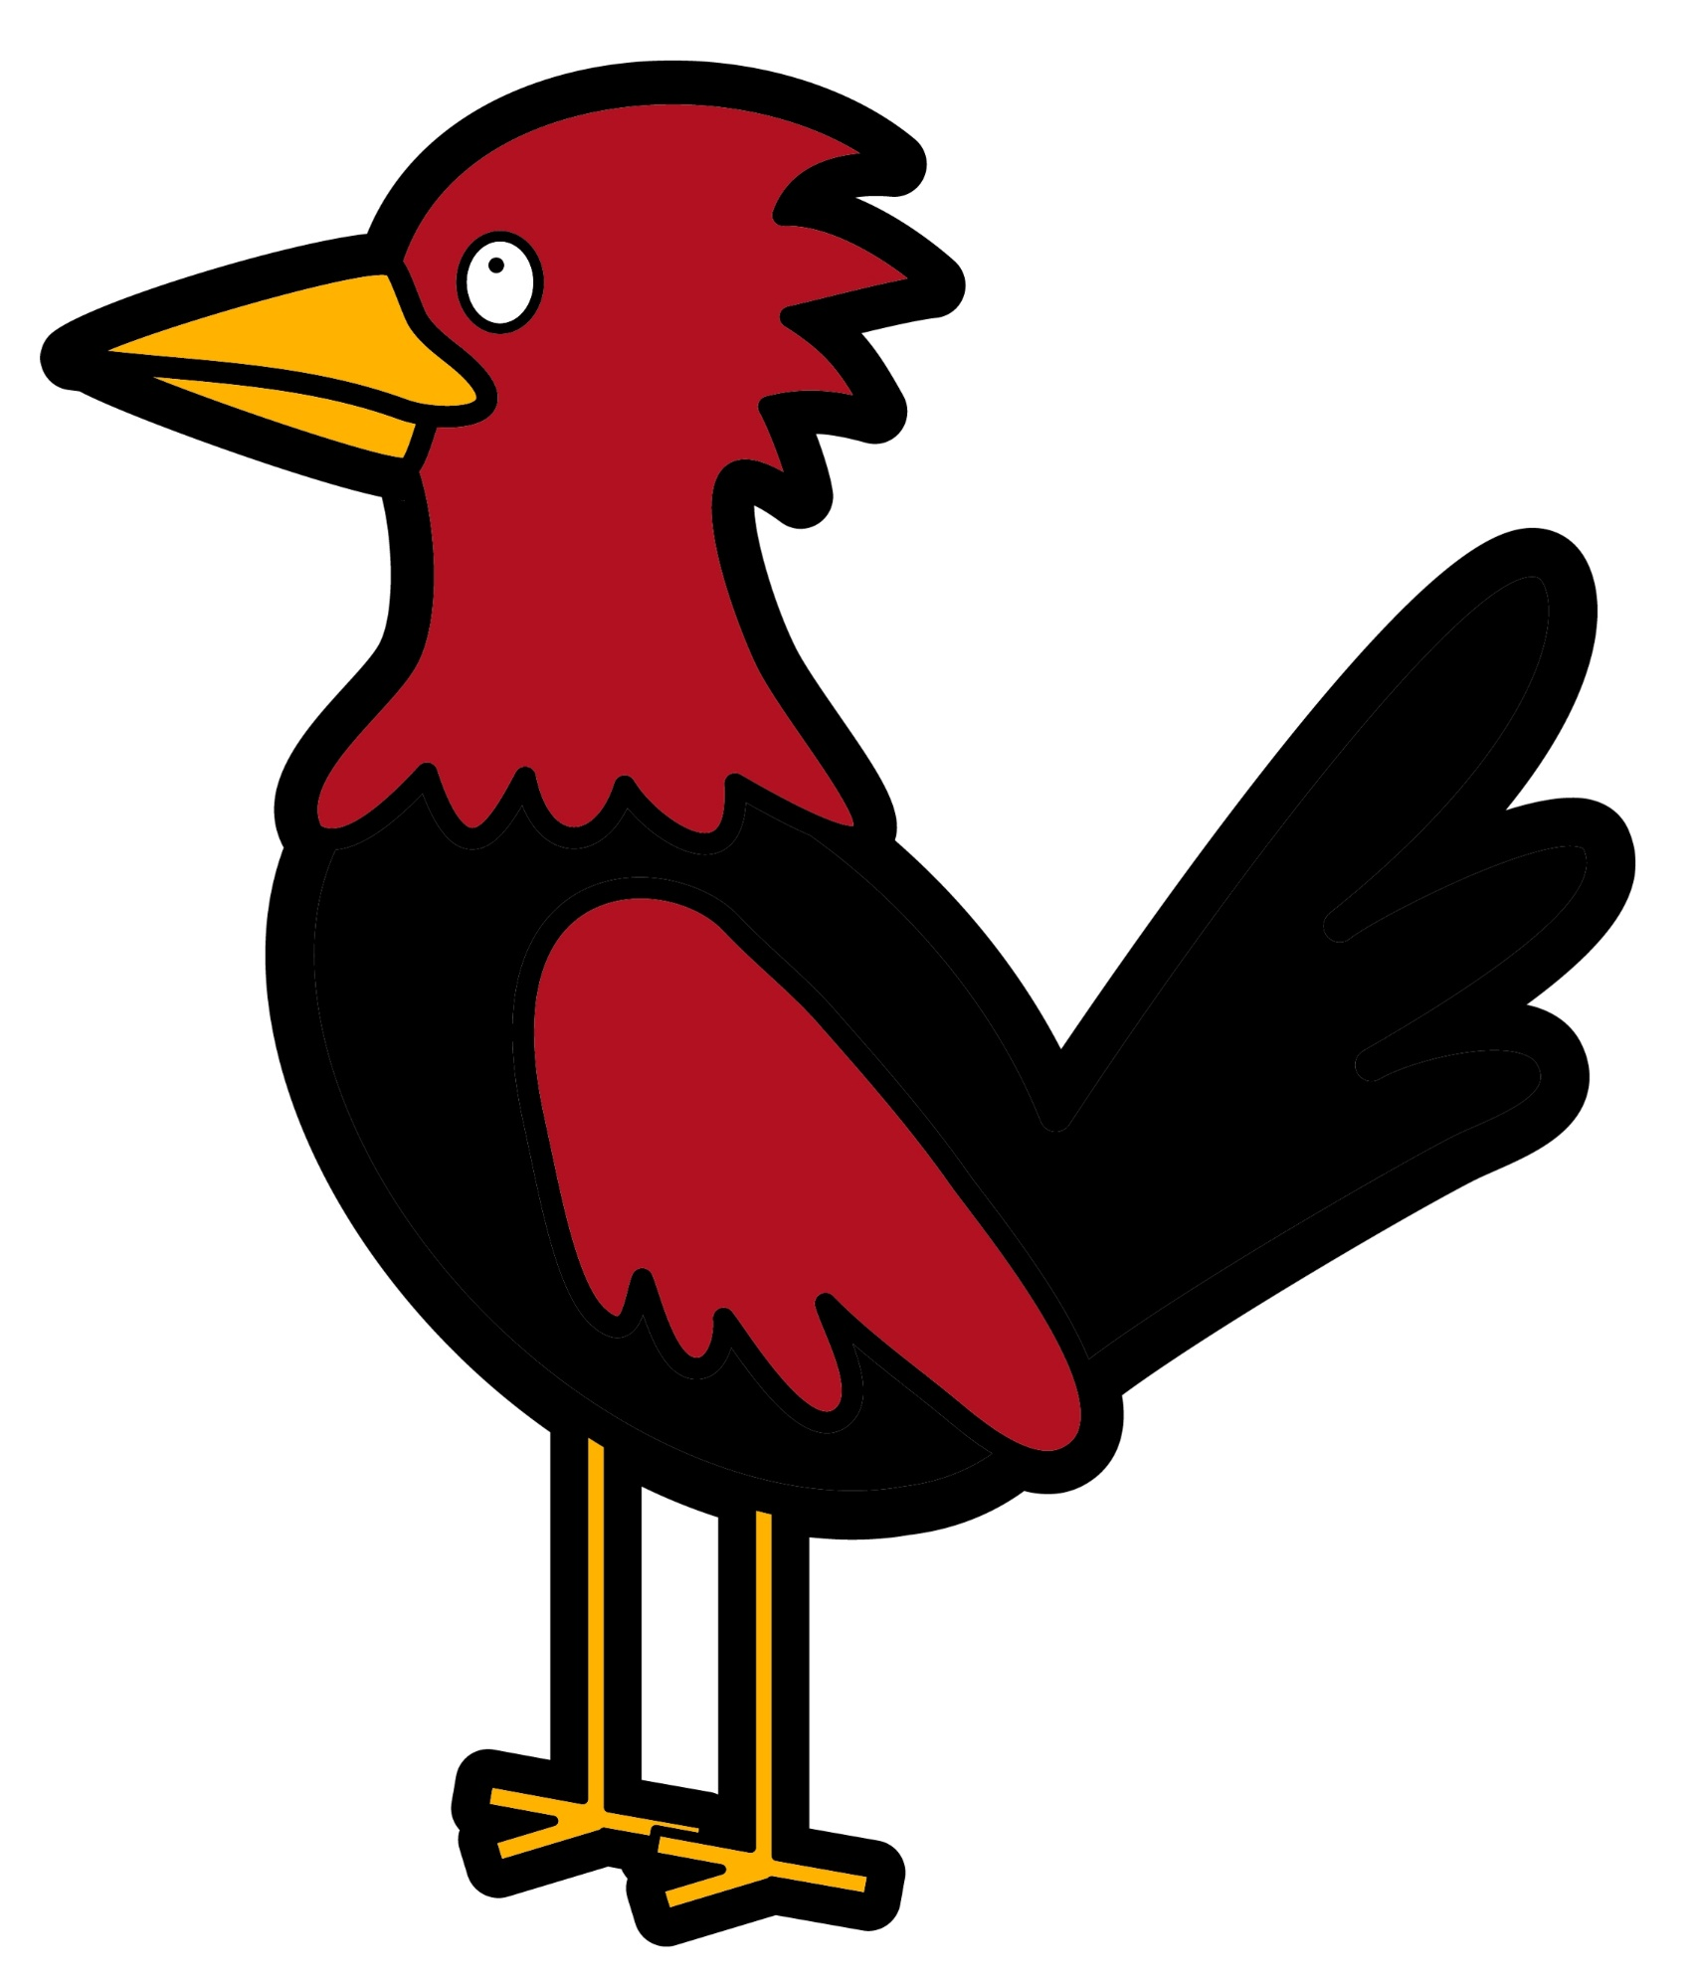
Common birds
BAT
WOODPECKER
PIGEON

Slide 14
Which number is the pigeon?
1
2
3
Number 3 is the pigeon

Slide 15
Which number is the bat?
1
2
3
Number 2 is the bat

Slide 16
Which number is the woodpecker?
1
2
3
Number 1 is the woodpecker

Slide 17
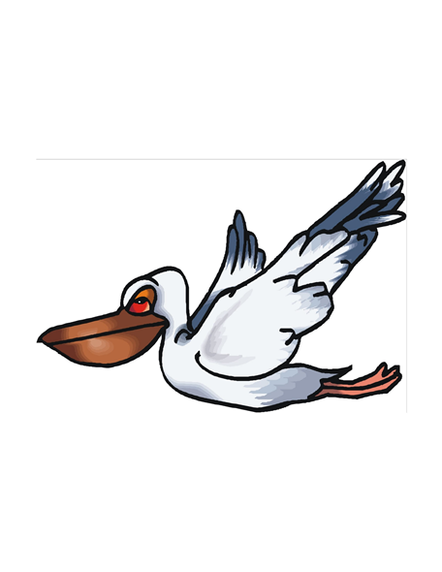
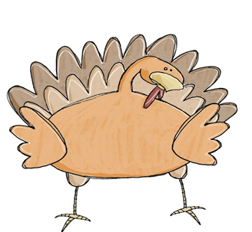
Common birds
OWL
PELIKAN
TURKEY

Slide 18
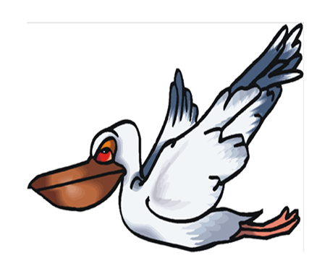
Which number is the pelikan?
1
2
3
Number 1 is the pelikan

Slide 19
Which number is the owl?
1
2
3
Number 3 is the owl

Slide 20
Which number is the turkey?
1
2
3
Number 2 is the turkey

Slide 21
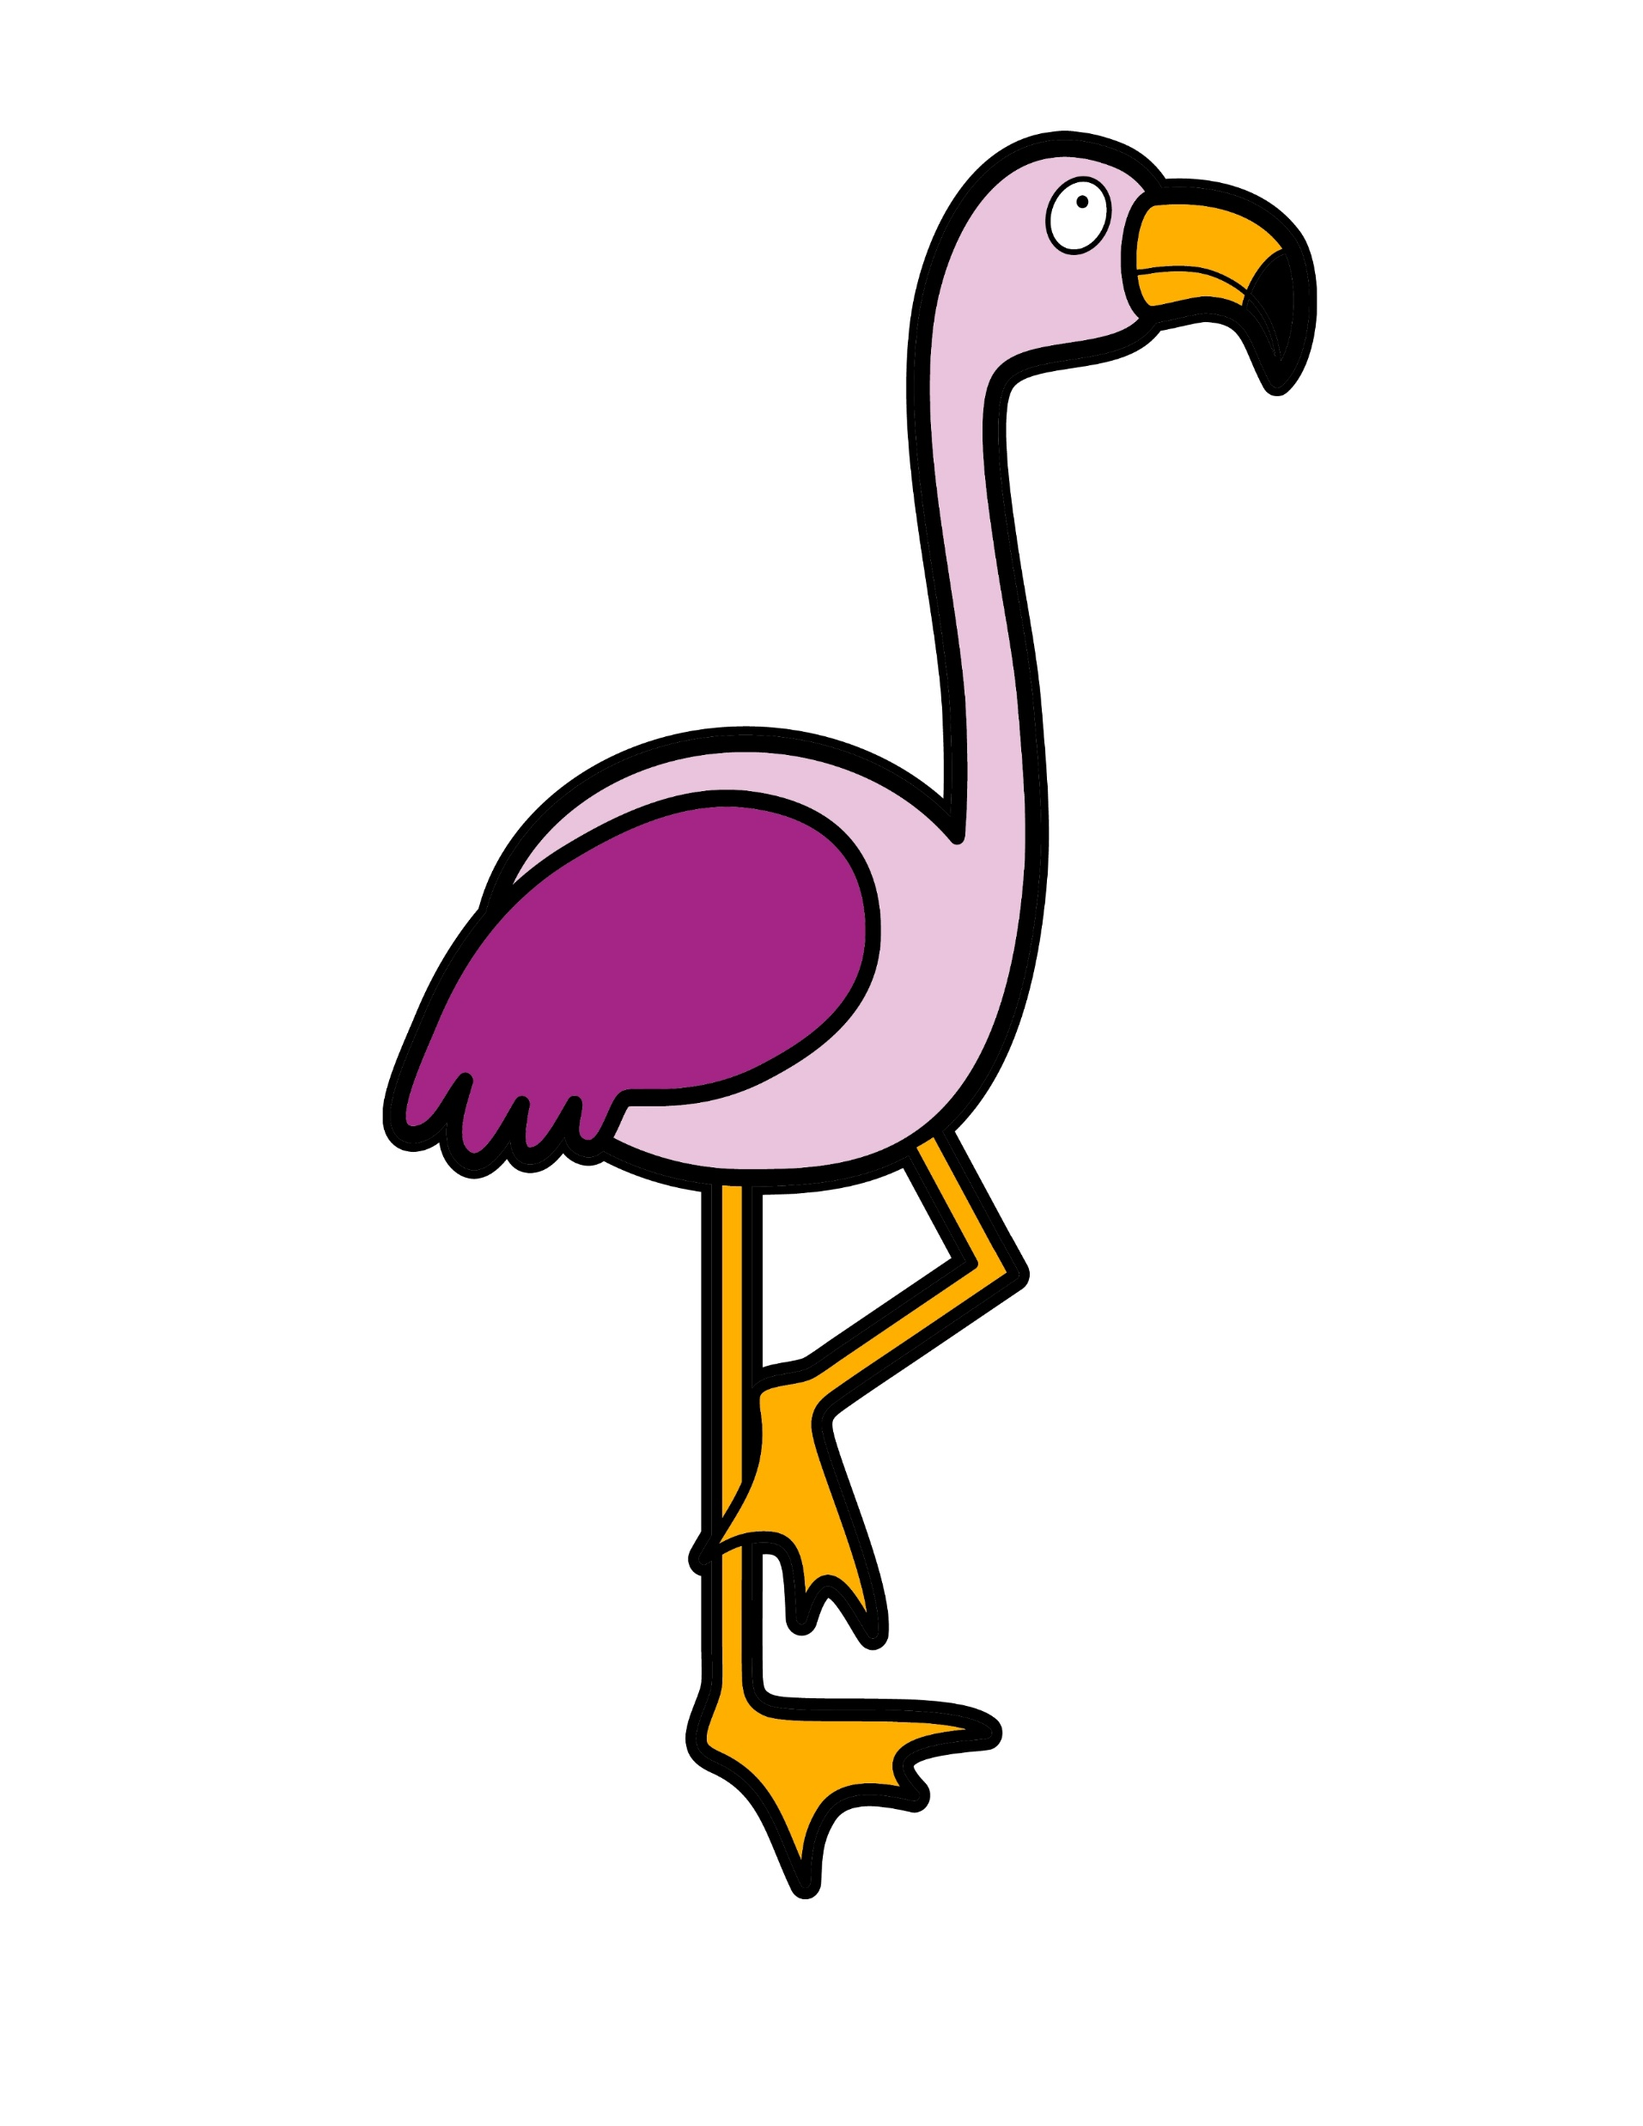
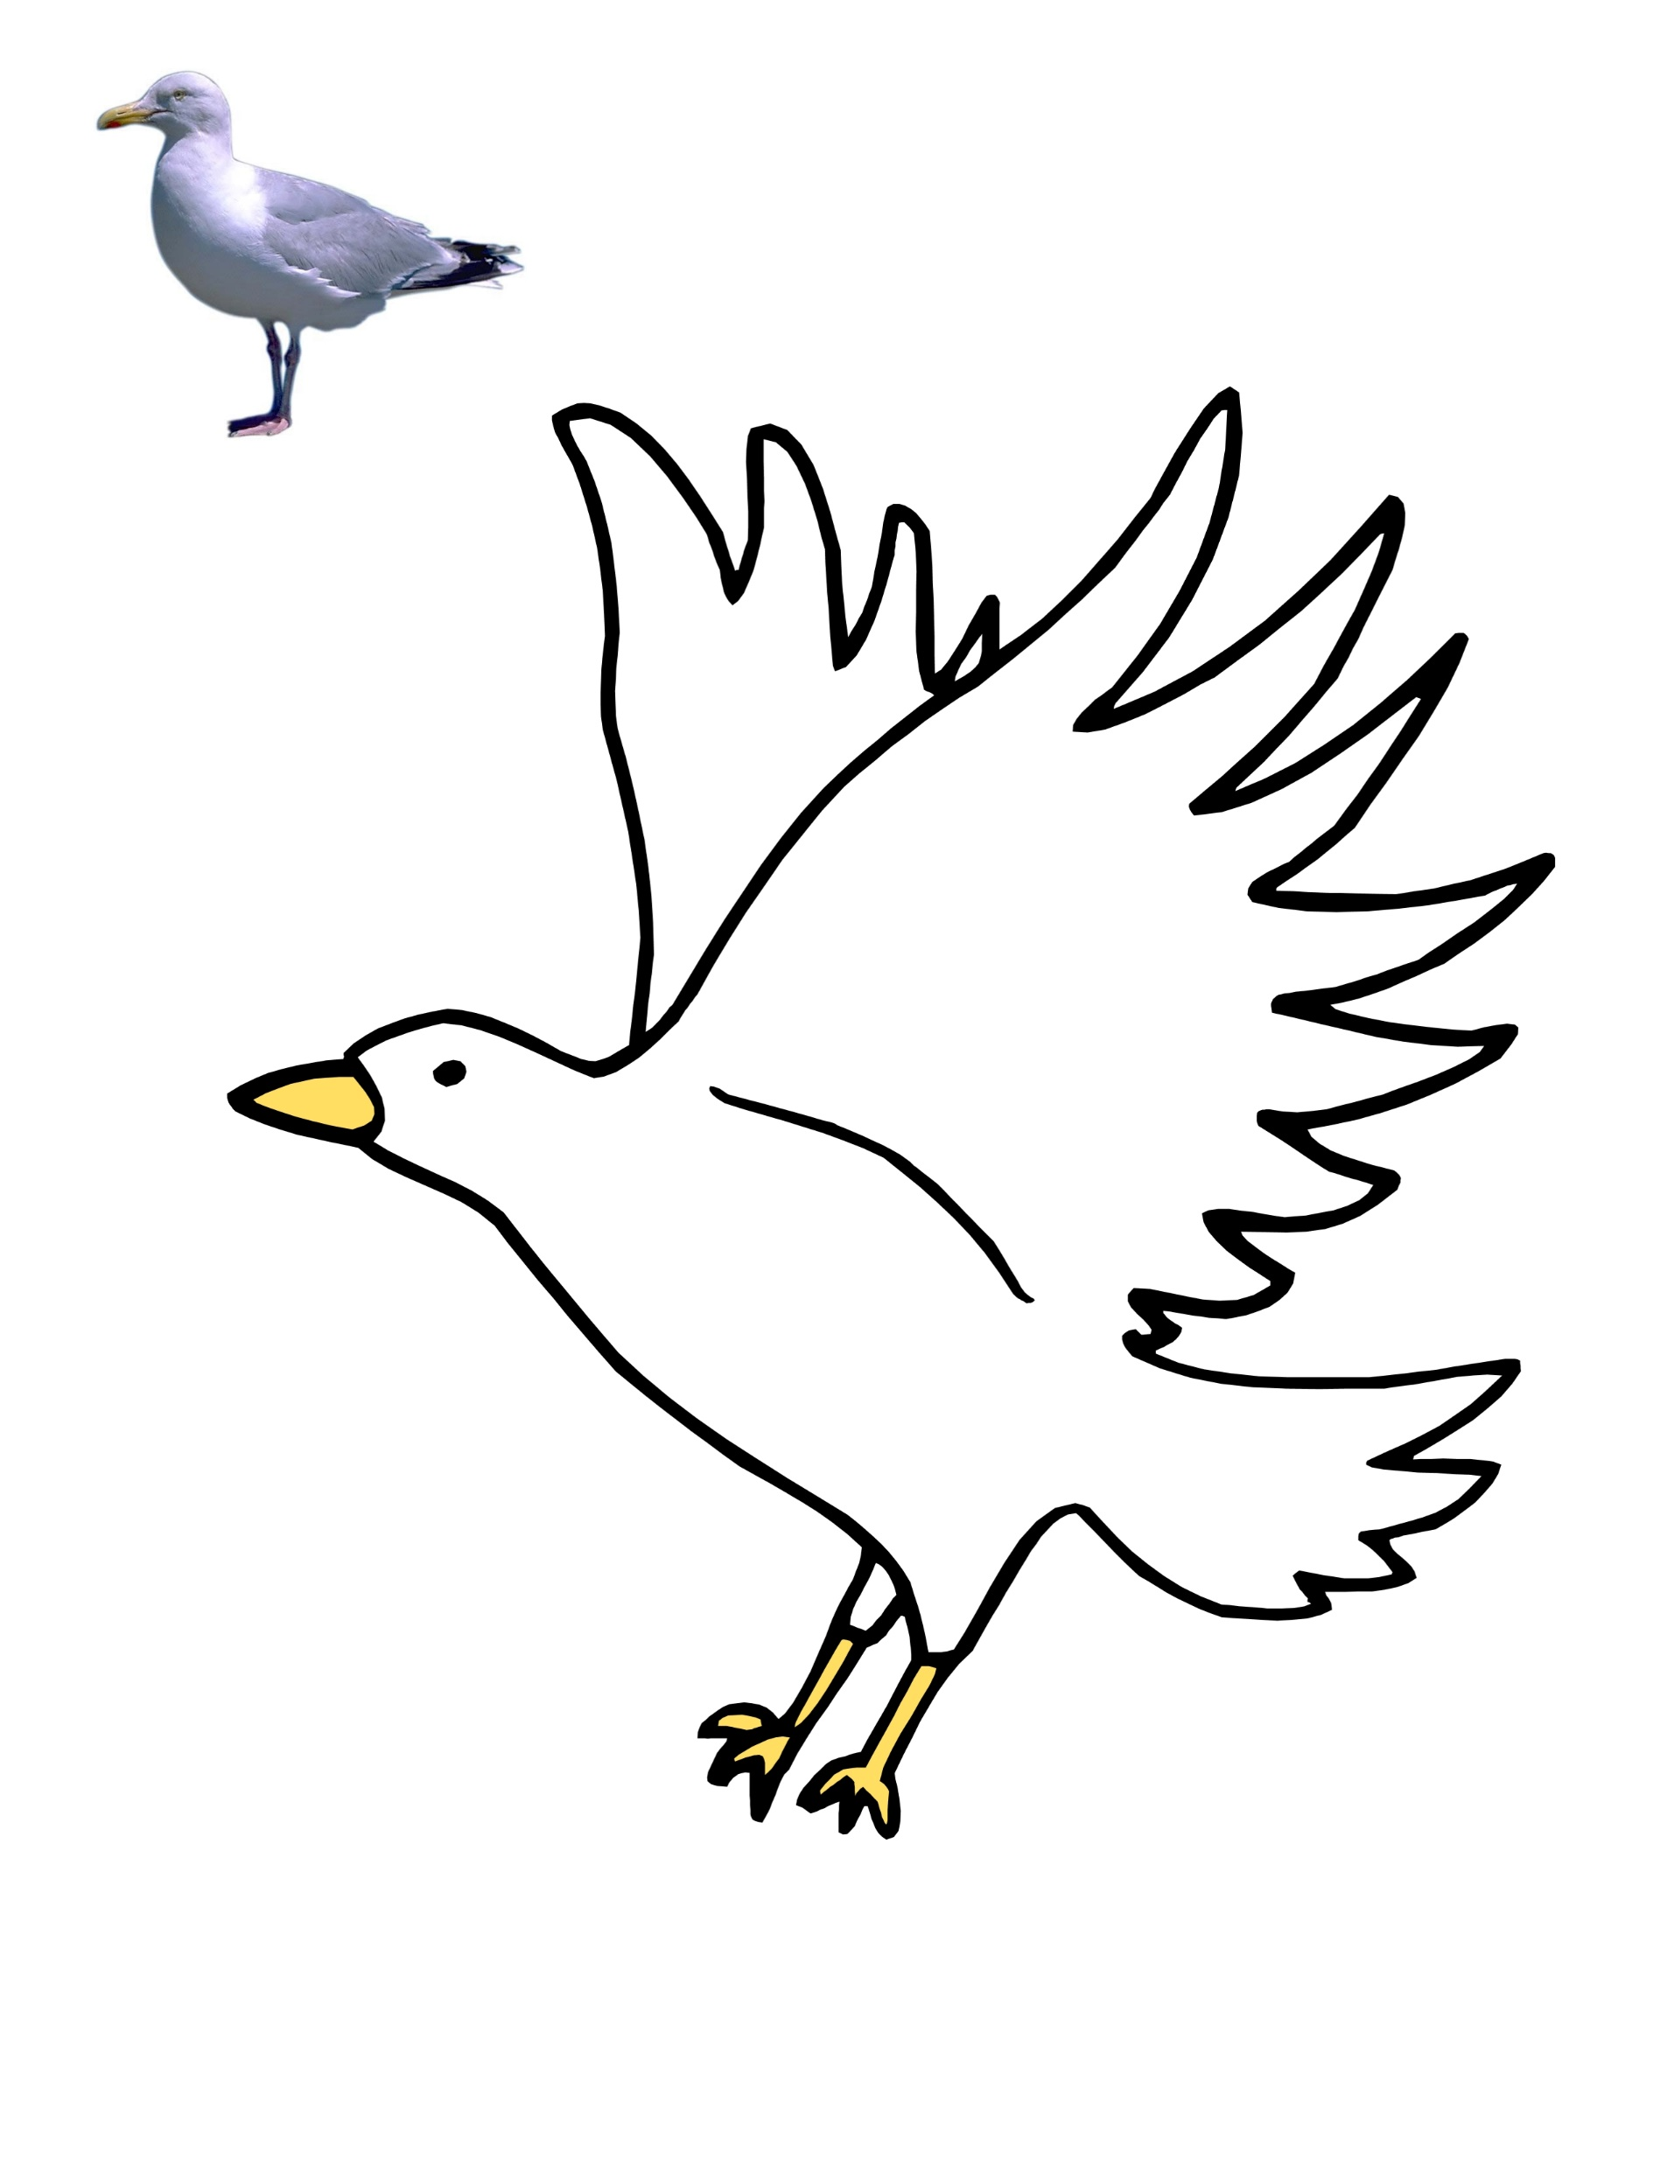
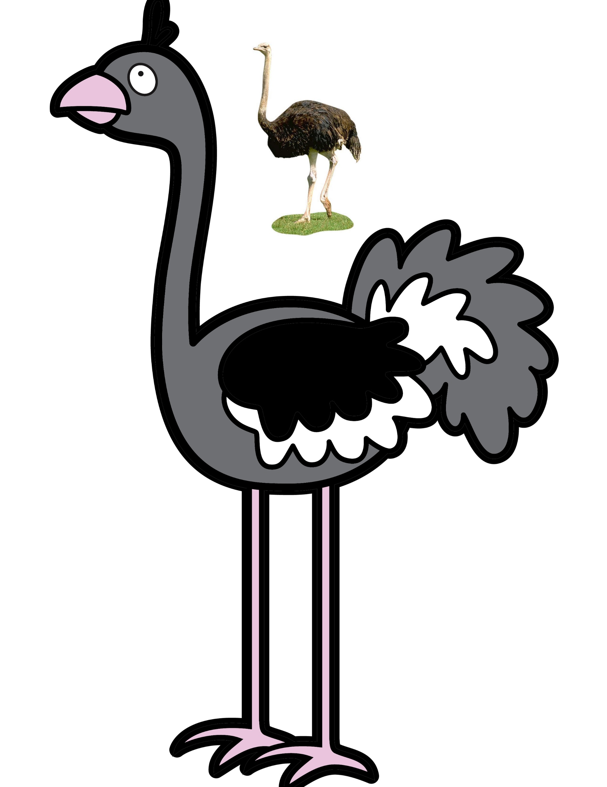
Common birds
SEAGUL
OSTRICH
FLAMINGO

Slide 22
Which number is the flamingo?
1
2
3
Number 1 is the flamingo

Slide 23
Which number is the ostrich?
1
2
3
Number 2 is the ostrich

Slide 24
Which number is the seagul?
1
2
3
Number 3 is the seagul

Slide 25
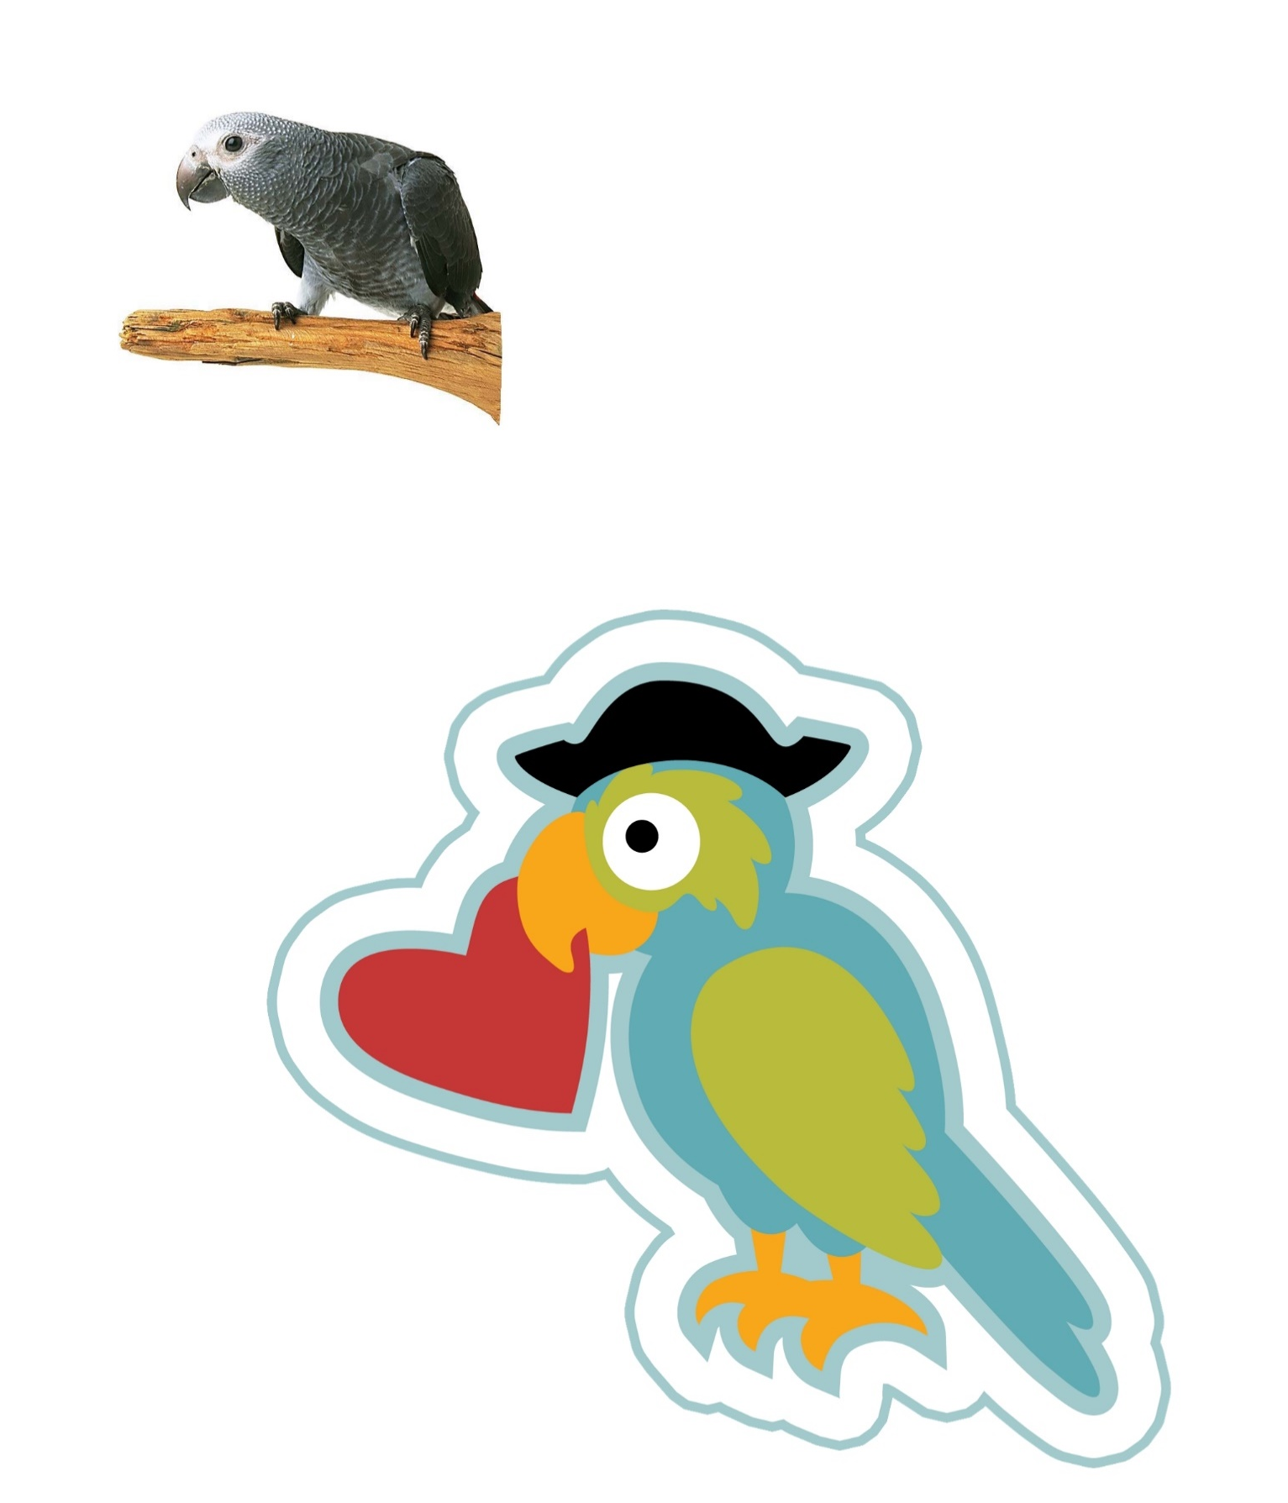
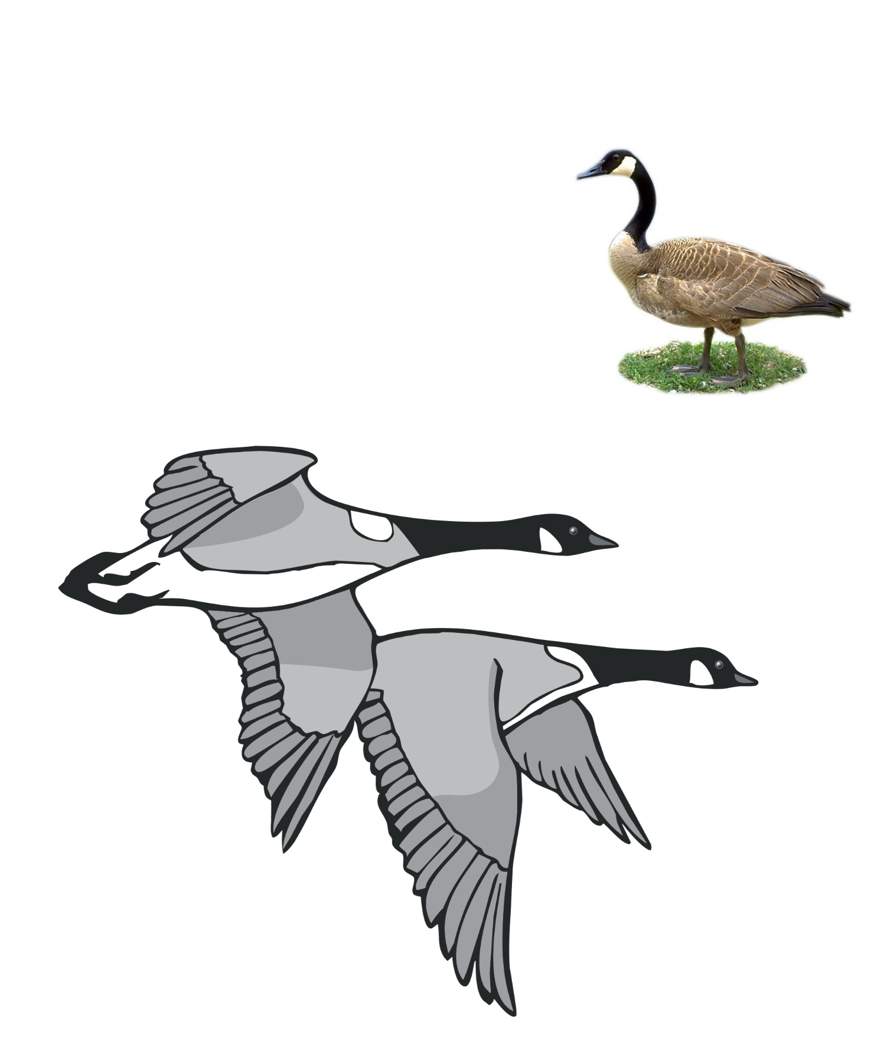
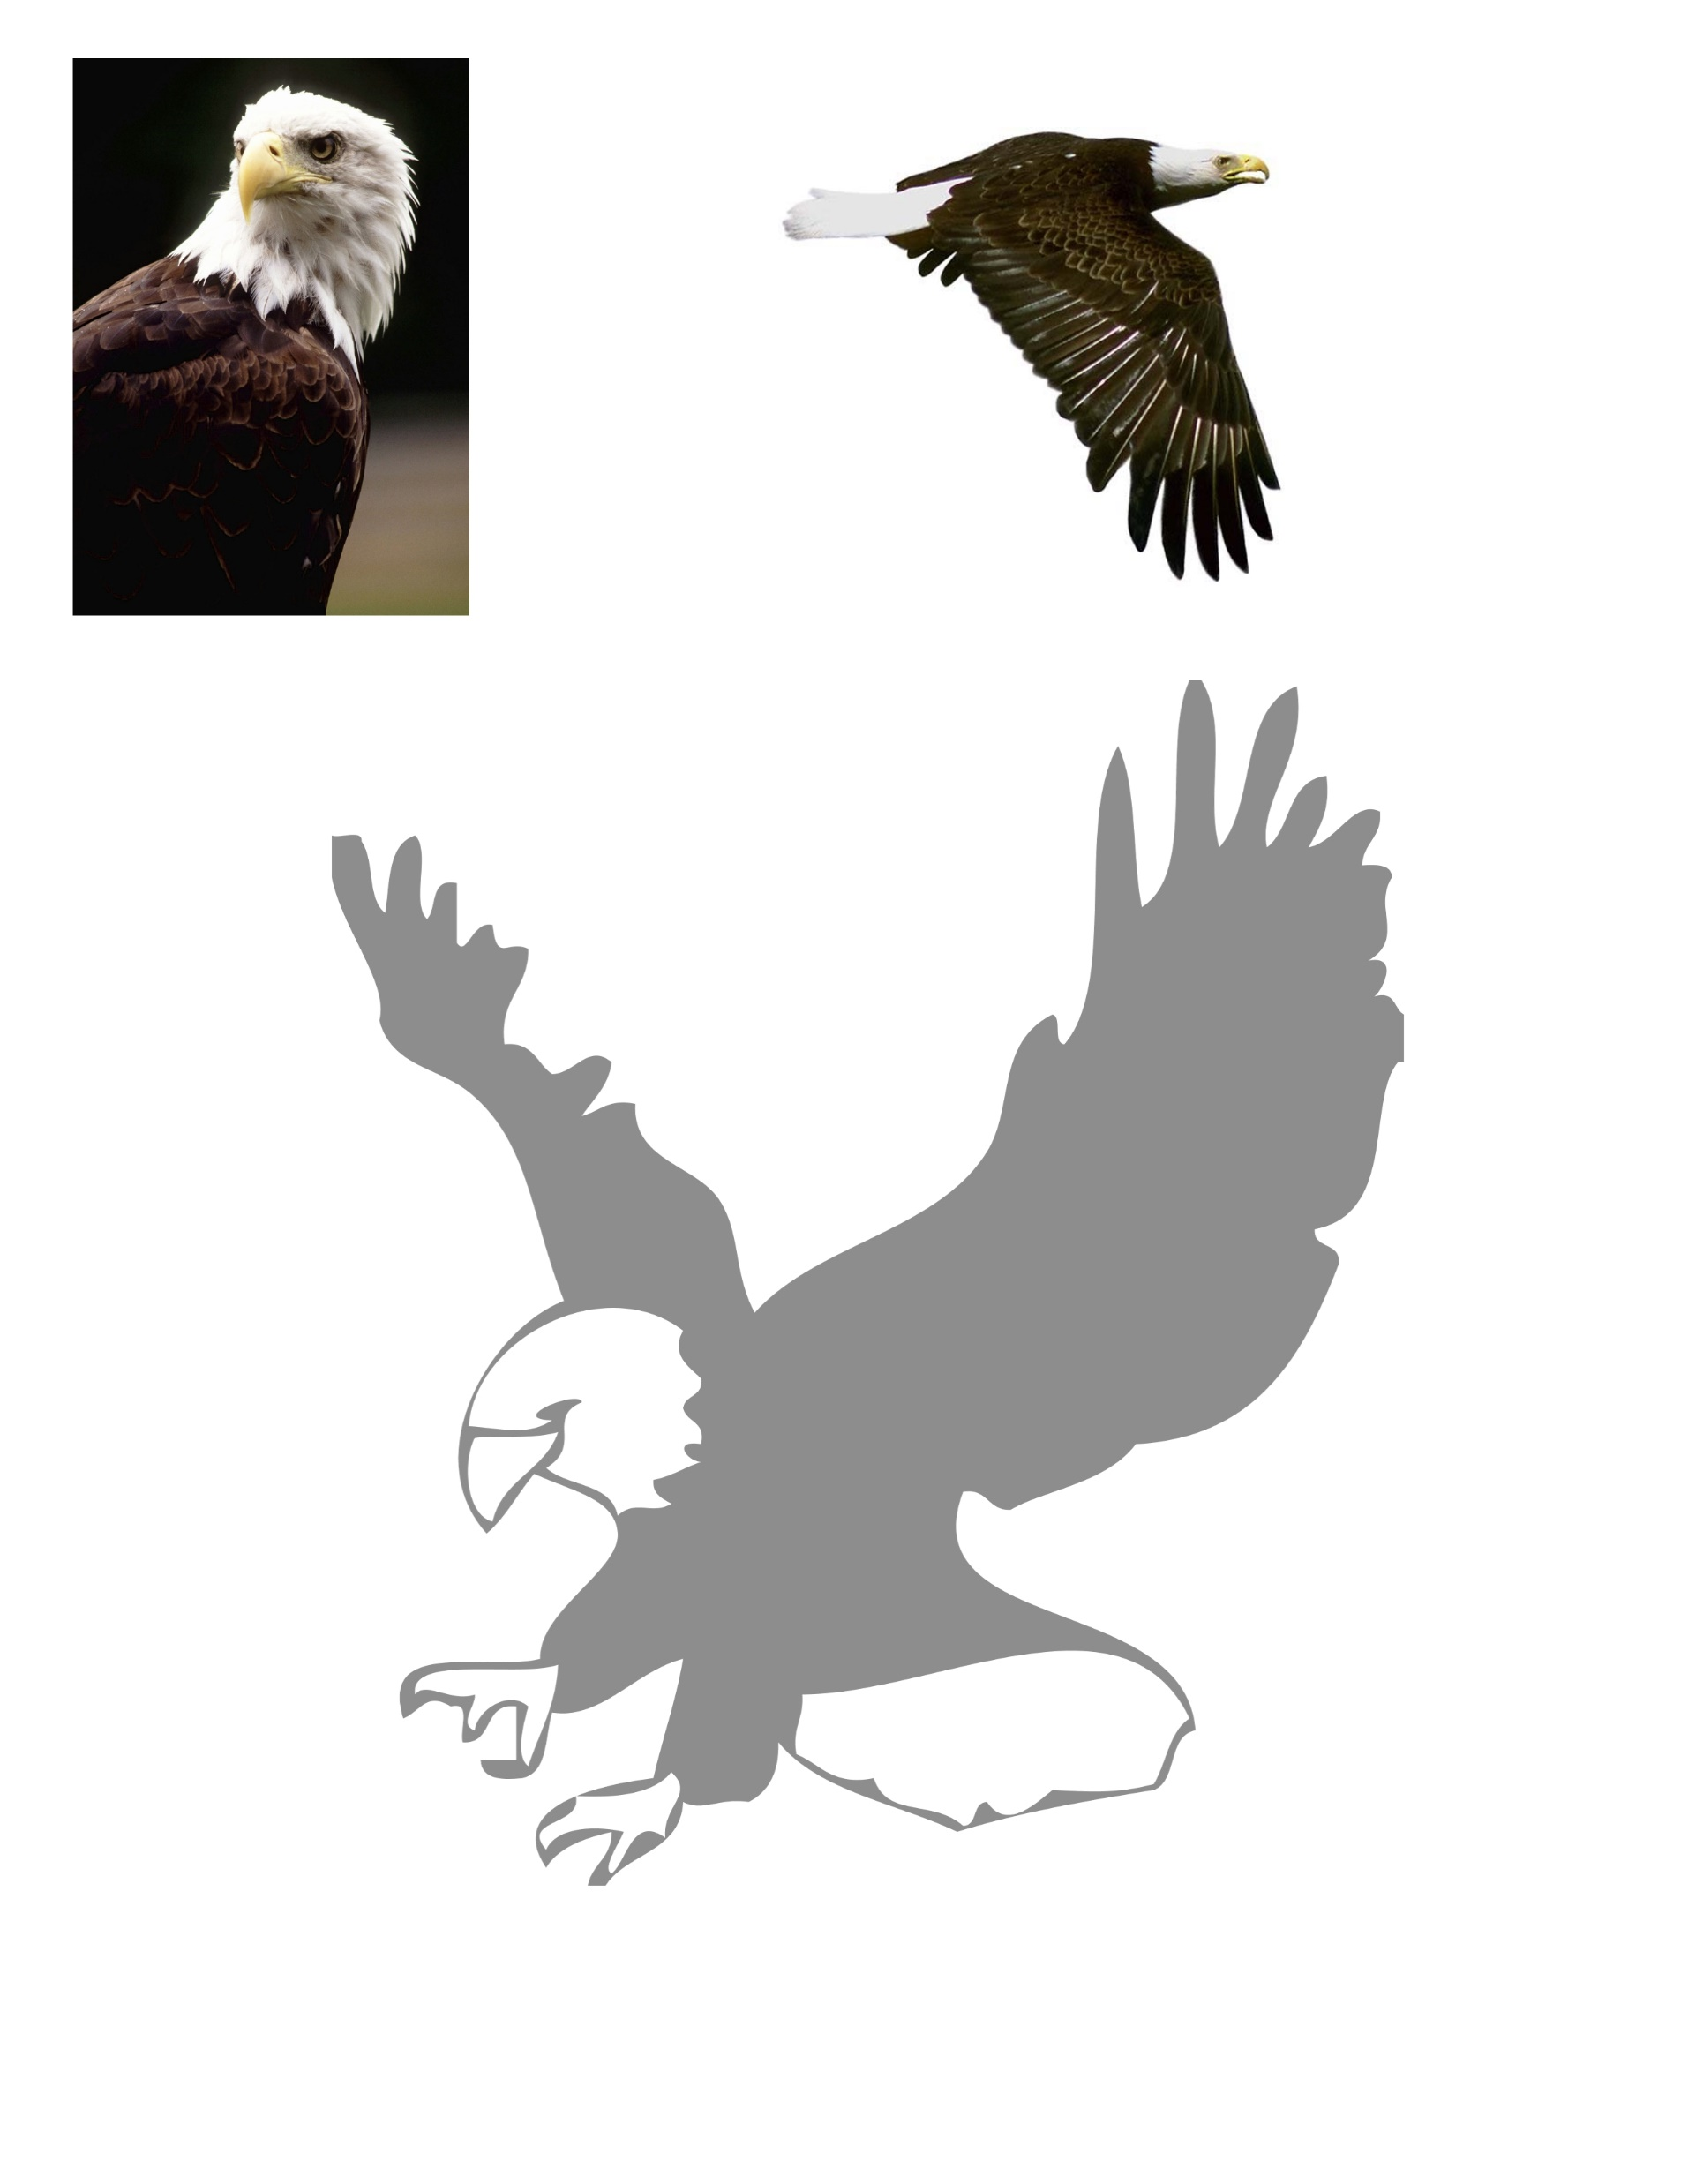
Common birds
GOOSE
PARROT
EAGEL

Slide 26
Which number is the parrot?
1
2
3
Number 2 is the parrot

Slide 27
Which number is the eagle?
1
2
3
Number 1 is the eagle

Slide 28
Which number is the goose?
1
2
3
Number 3 is the goose

Slide 29
How do birds fly

Slide 30
Bird story

